Slide 1
On the Tilt of Gaseous and Stellar Disks Around the Galactic Black Hole
Mark Morris UCLA

Slide 2
ABSTRACT -- The well-defined, massive disk of young stars orbiting within 0.5 pc of the Galactic black hole (GBH) is strongly tilted with respect to the Galactic plane. In the context of in situ formation mechanisms, this orientation is inherited from that of the gas disk that formed these stars on the order of 6 million years ago. The tilt can be understood by positing that clouds fall toward the GBH on near-zero angular momentum orbits and form dispersion rings as they self-intersect after passing through periapse in their orbits around the GBH. If the angular momentum distribution of the approaching clouds is isotropic, then the resulting gaseous disks will be oriented at random. However, in a galaxy having m=2 symmetry, radial orbits are very unlikely for dense clouds massive enough to account for the central stellar cluster of young stars, since such clouds are constrained by their history to orbit in the Galactic gas layer, largely following streamlines in the Central Molecular Zone (CMZ) as they migrate toward the GBH under the action of dynamical friction. Encounters with other massive clouds that might be capable of placing a cloud on a near-radial orbit are more likely to lead to cloud mergers. We suggest -- and illustrate with a toy model -- that near-radial orbits, and thus strongly tilted disks, occur naturally if the Galaxy has a significant m=1 asymmetry, that is, if the massive constituents of the Galactic center undergo oscillatory motions about the Galactic center of mass,. Indeed, the CMZ is clearly asymmetric in both position and velocity, consistent with the operation of an m=1 oscillatory mode. Not only can this give rise to strongly tilted disks, but it also enhances the time-averaged accretion rate onto the GBH. This mechanism can also have important consequences for the fueling of AGNs.

Slide 3
Outline of talk:
Statement of the problem –
highly inclined stellar disk(s) around SMBHs imply highly inclined gaseous precursors
such highly inclined gas disks are difficult to produce
2. Steps toward a solution (focus on Galactic center, but should have general applicability) –
m=1 modes in galaxies, both tilts and off-center displacements
Oscillatory motions of central cluster/SMBH
The Model
Tilt of gas layer + oscillation of nucleus → large-angle encounters between gas clouds and black hole
Tidal streams self-intersect, forming “dispersion rings”
4. Caveats, Implications for AGN Fueling

Slide 4
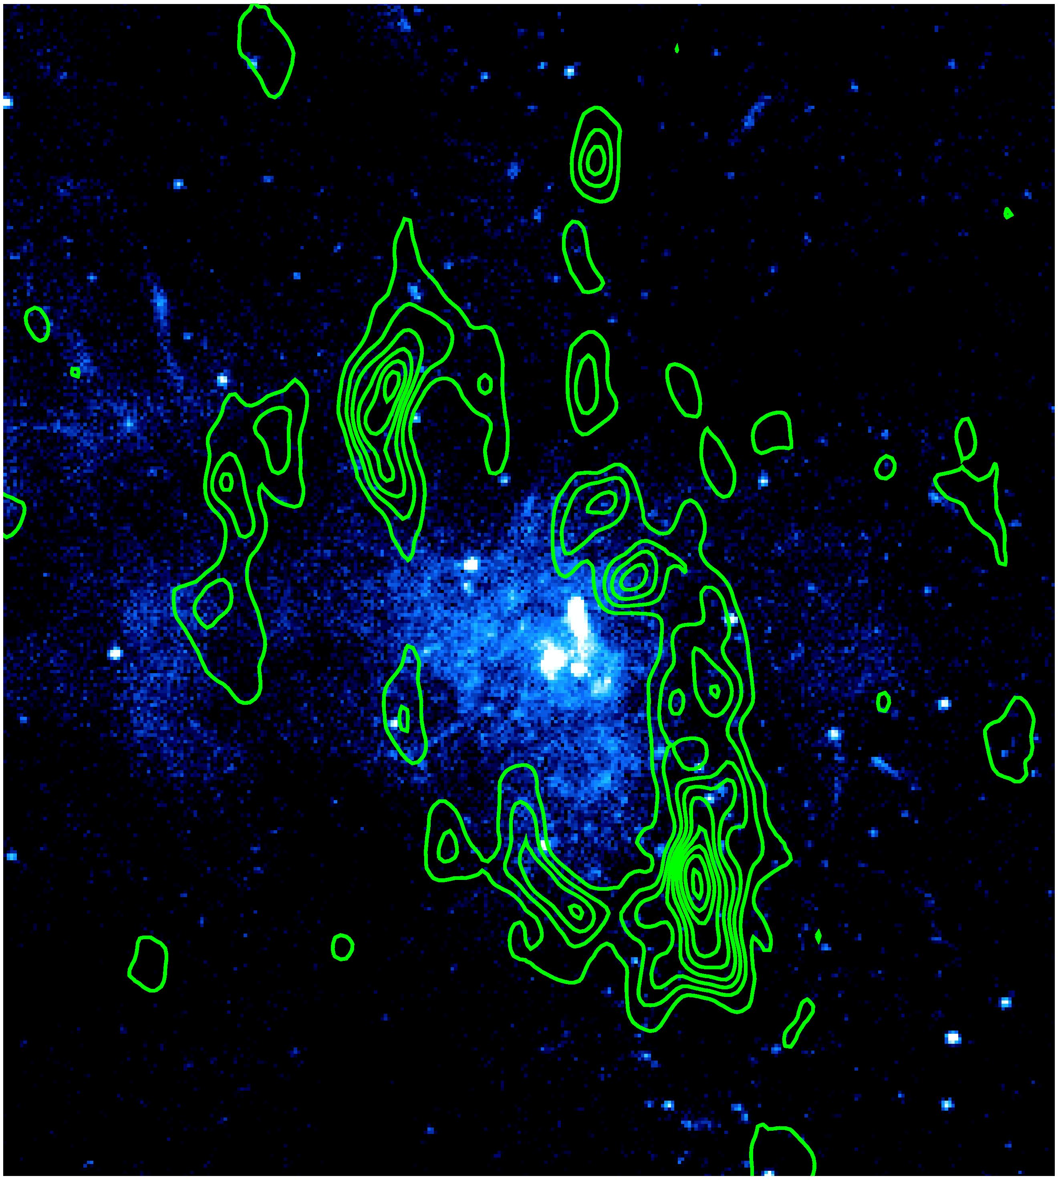
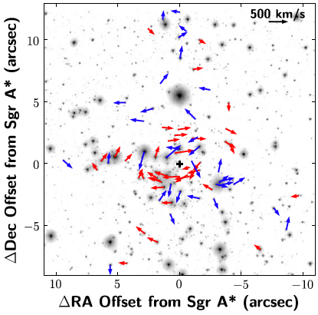
1 pc
The stellar disks (Lu et al. 2008)
0.3 pc
The circumnuclear disk
HCN contours from Christopher et al. (2005) on the Chandra deep
image of the Galactic center (Baganoff et al.)

Slide 5
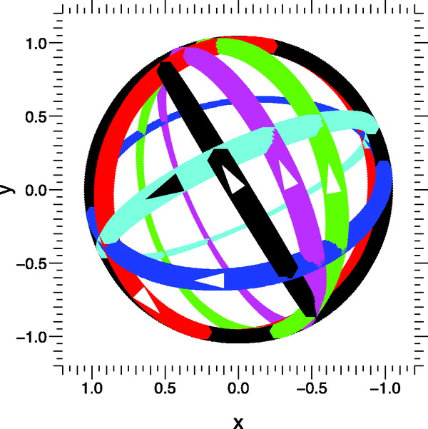
The various planes (figure from Paumard et al. 2006)
Galaxy circumnuclear disk
clockwise stellar disk
possible ccw stellar disk

Slide 6
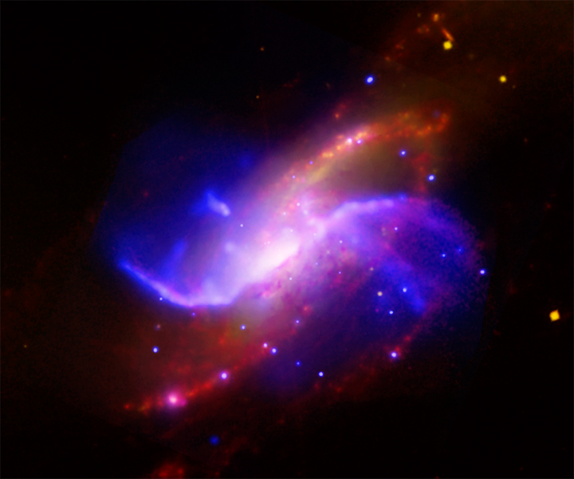
NGC4258

Slide 7
Adopt in situ formation model for stellar disks →
Requires progenitor gas disks that are extremely tilted
How does such a tilt arise?
One answer (the one that has largely been adopted by the community):
→ clouds fall in on low (or zero) angular momentum orbits, and are tidally deformed and stretched. → They self-intersect, forming a “dispersion ring”

Slide 8
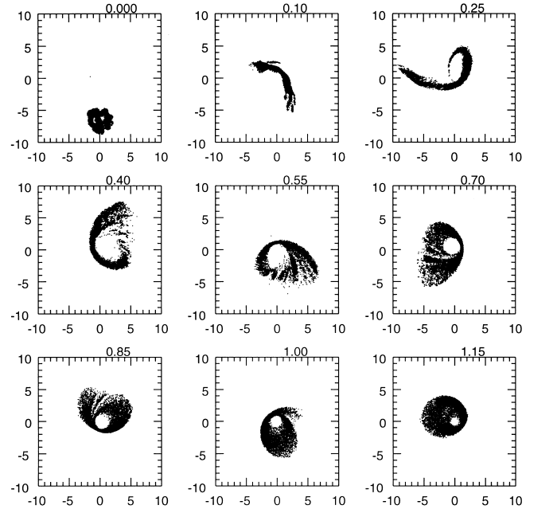
Initial tangential velocity = 40% of that needed for a circular orbit. But this circularizes outside of 1 pc.
R.H. Sanders 1998
Units: parsecs

Slide 9
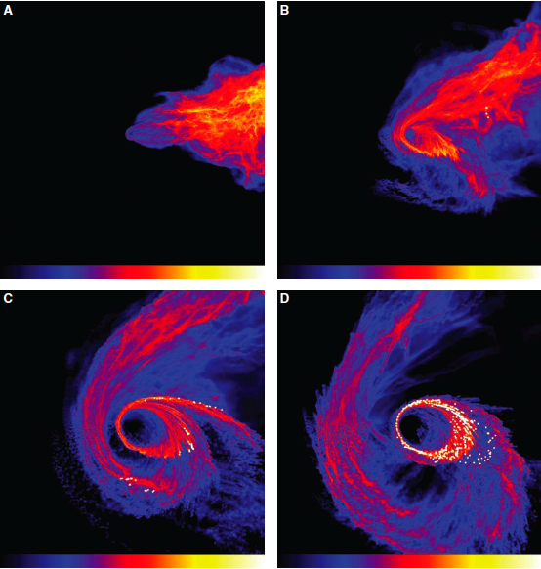
More recent work ((SPH model) of Bonnell & Rice (2008) goes all the way to the formation of the stellar cluster, starting from a cloud on a radial orbit:

Slide 10
BUT, how do clouds achieve zero angular momentum?
This resonates with the classical question of how to feed AGNs
In fact, this is very difficult !
In a galaxy having m=2 symmetry [ ρ(r,φ) ~ f(r) e^{imφ} ], radial orbits are very unlikely for dense clouds massive enough to account for the central stellar cluster of young stars
Such clouds are constrained by their history to orbit in the Galactic gas layer, largely following streamlines in the Central Molecular Zone as they migrate toward the GBH under the action of dynamical friction.
Encounters with other massive clouds that might be capable of placing a cloud on a near-radial orbit are more likely to lead to cloud mergers.

Slide 11
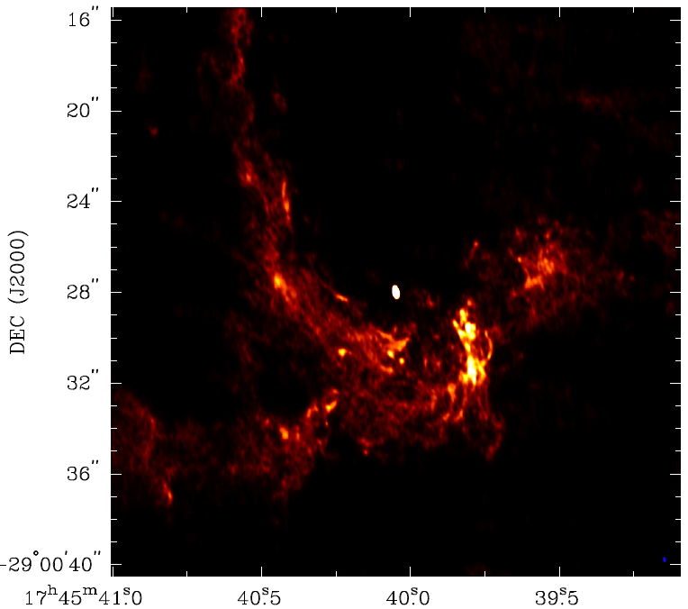
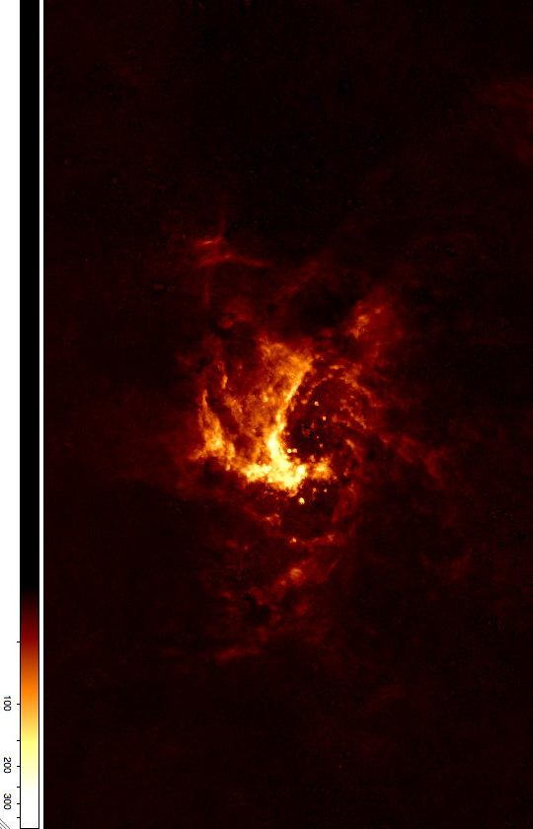
There is one near-zero angular momentum feature that one can point to in the Galactic center – the Northern Arm
Zhao et al 2009 – 1.3cm VLA
Inside edge of circumnuclear disk
But its mass is two orders of magnitude too small to account for something like the central cluster of young stars.
Wang et al. 2009 – Paschen-α

Slide 12
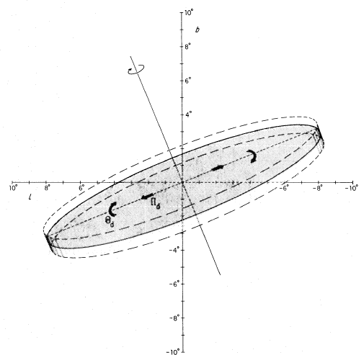
Background to the model to produce near-zero angular momentum clouds:
First note that the Galaxy (and perhaps most galaxies in general?),
has, in addition to its m=2 symmetry (bar), two kinds of m=1 modes:
a tilt of the inner gas layer
model based on CO & HI
Burton & Liszt 1978; Liszt & Burton 1978
Angle between the Galactic plane
and the gas layer ~25º
a displacement of the gas layer

Slide 13
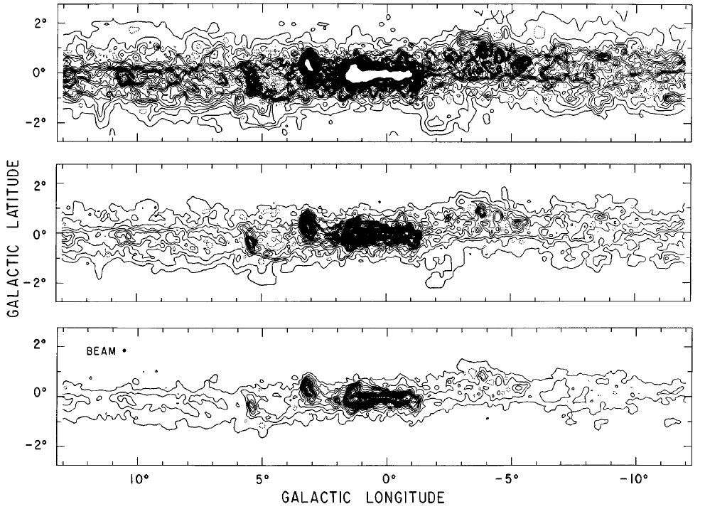
Notice the tilt of the gas layer!
Carbon monoxide emission along the galactic plane, from Bitran et al. 1997, A&A Suppl. 125, 99

Slide 14
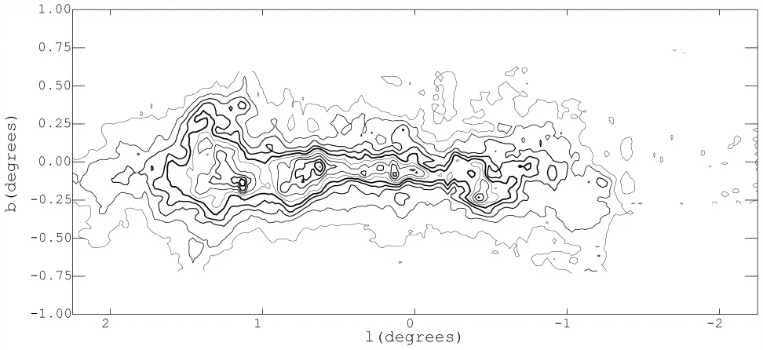
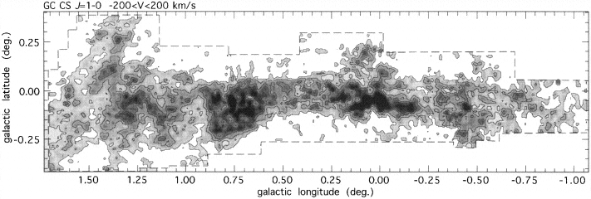
150 pc

Slide 15
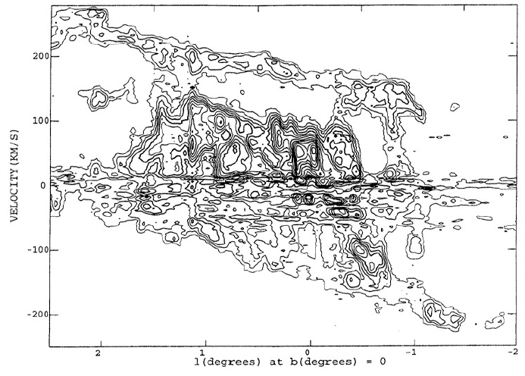
Longitude-Velocity diagram for ¹²CO Bell Labs ¹³CO survey (Bally et al.)

Slide 16
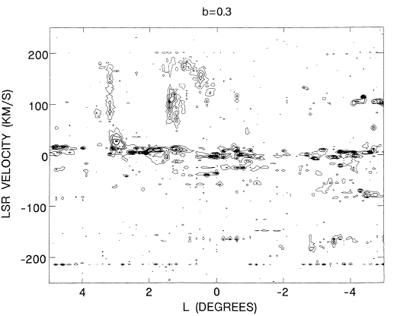
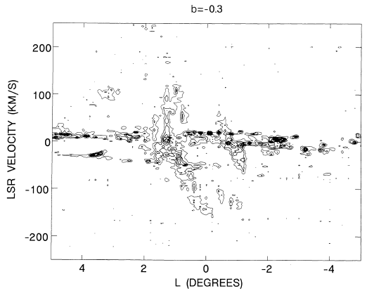
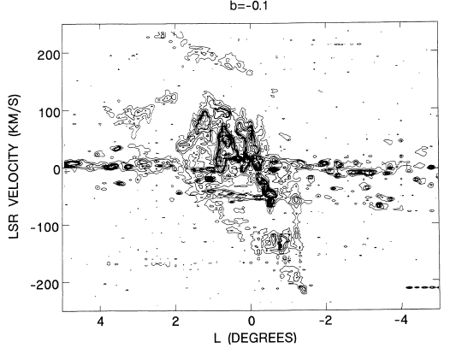
The gas in the parallelogram (X1 orbits) extends much higher in Galactic latitude
than the gas in the interior of this feature (X2 orbits), AND it may be warped or tilted.
Data from Bally et al. (1987, ApJS 65, 13)

Slide 17
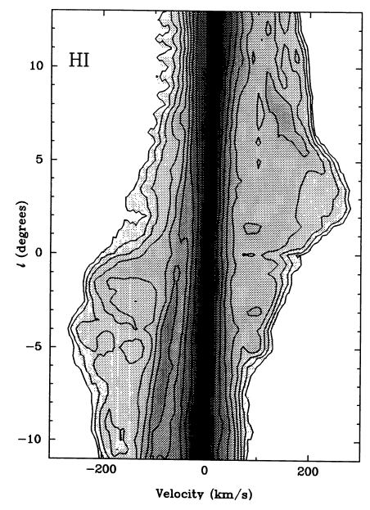
Blitz 1994:
Velocity offset of both HI and CO from zero V_{lsr}
~32 km/s
Longitudinal offset ~ 0.3º
H. Liszt

Slide 18
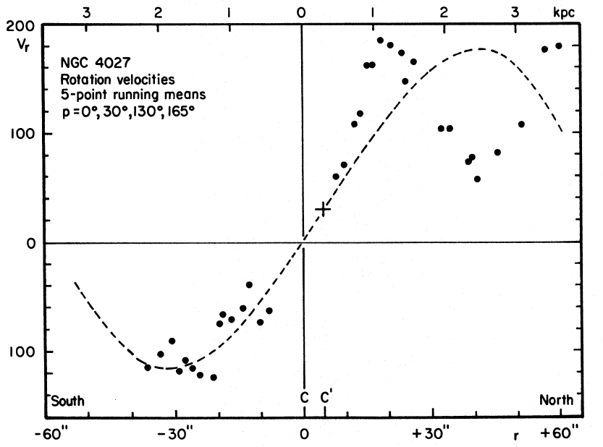
Off-center galactic nuclei have also been noted elsewhere, and ascribed to m=1 modes
Christiansen & Jefferys 1976

Slide 19
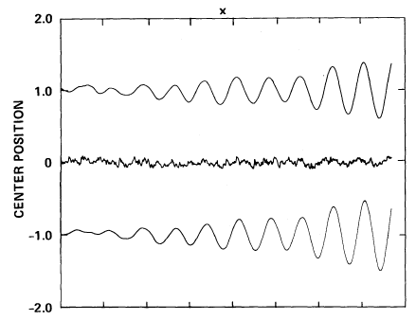
Theoretical motivation for understanding this phenomenon.
Miller & Smith 1992: the nucleus of a Galaxy orbits around the mass centroid
particle trajectory
position of potential center
Hypothetical harmonically bound particle driven by motions of the potential center
Martin Weinberg (1994): King models exhibit very weakly damped m=1 modes, damping over 10’s to 100’s of crossing times. … peak density shifts from, and slowly revolves around, the initial center.

Slide 20
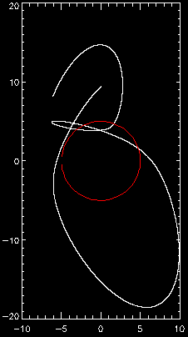
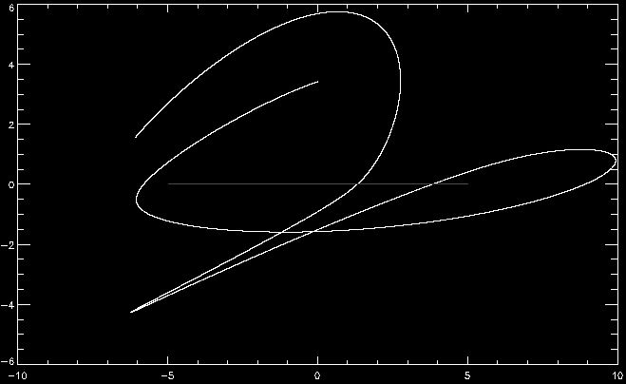
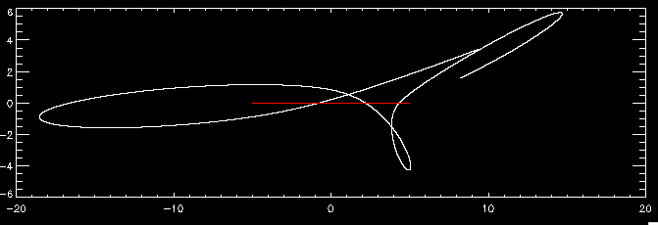
Illustration of model’s viability:
Single-particle trajectory (white) in presence of black hole and central cluster undergoing circular harmonic motion (centroid in red)
X-Y
osc, 5., 1.,60000,60.,10.
Phase lead = 90. amp = 5 pc period = 1 Myr
981000 years vtot_init = 60 km/s initial radius = 10 pc
Tilt = 20 deg theta = 45 deg.
X-Z
Y-Z

Slide 21
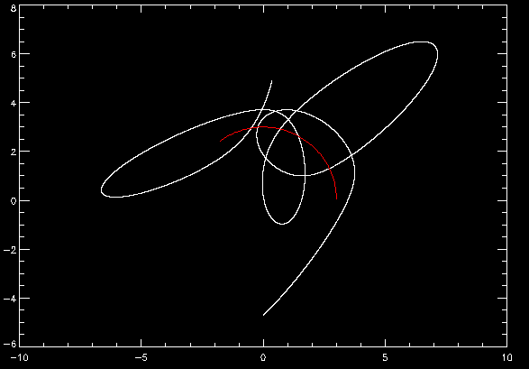
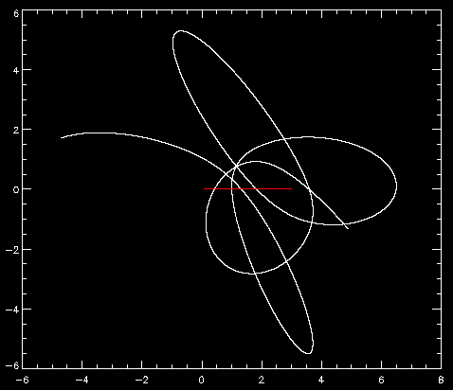
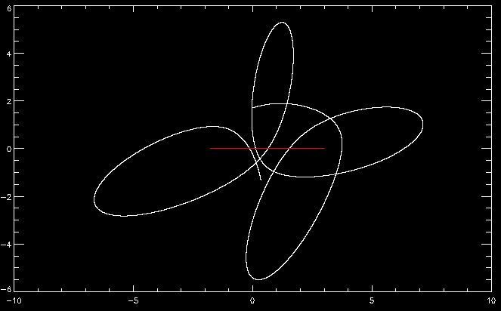
Illustration of model viability - 2:
Single-particle trajectory (white) in presence of black hole and central cluster undergoing circular harmonic motion (centroid in red)
X-Y
Y-Z
X-Z
osc, 3., 2., 100000, 70, 5
Phase lead = -90. amp = 3 pc
period = 2 Myr
700000 years vtot_init = 70 km/s
initial radius = 10 pc, Tilt = 20 deg

Slide 22
Caveats: No stellar displacement yet detected in GC
Mark Reid’s limit on the in-plane motion of SgrA* ~ 20 km/s
Implication: AGN accretion can be enhanced without calling on mergers, IF the BH is harmonically displaced from the galactic potential minimum.
Conclusions: – Strongly tilted disks are not well motivated for isolated galaxies
– m=1 modes involving both tilts of the gas layer and dislplacements of the central black hole (& its stellar entourage) offer a potential way of understanding strong disk inclinations

Slide 24
The Limit Cycle
1. Disk
2. Starburst in disk, triggered by accretion onto central BH or by achieving critical surface mass density.
3. Central disk evacuated
Quasi-steady gas inflow
4. Stellar winds maintain central
cavity (outer disk builds up)
5. Stellar winds fade out (~10⁷ yrs)
6. Disk undergoes viscous evolution and migrates into cavity

